Slide 1
CNS PROJECT
TEAM MEMBERS
SAI SHANKAR 2010030054
PS YESHWANTH 2010030122
SRIKAR KANCHE 2010030474
SAI MANASWI 2010030325
Mentor: P Lalitha Surya Kumari

Slide 2



TEXT ENCRYPTION USING AES ALGORTHIM

Slide 3

TABLE OF CONTENTS
ABSTRACT
INTRODUCTION
METHODOLOGY
FLOW CHART
ALGORITHM
IMPLEMANTION
CONCLUSION

Slide 4
ABSTRACT
In the project The messages that we sent from the source to the destination is not securable. There is no guarantee that the destination receives the complete message as expected.
So here we had proposed a algorithm where user will enter the plain text and select the algorithm type from AES cryptography and provide the key.
a chipper text will be formed that can be sent via any communication application and end user can decrypt the text by selecting the same algorithm type and must enter the same sender secret key.
By using this method you can double ensure that your secret message is sent securely without outside interference of hackers or crackers.

Slide 5
INTRODUCTION
Text-encryption is a process in which the message send by the sender is encrypted so that only receiver can understand the message.
Encryption converts data into scrambled text. The unreadable text can only be decoded with a secret key.
The decoded text can be read by the receiver which maintains the security
Encryption The process of converting plaintext into ciphertext
Decryption The process of converting ciphertext into plaintext

Slide 6


METHODOLOGY
AES ALGORTHIM
The AES Encryption algorithm (also known as the Rijndael algorithm) is a symmetric block cipher algorithm with a block/chunk size of 128 bits
. It converts these individual blocks using keys of 128, 192, and 256 bits. Once it encrypts these blocks, it joins them together to form the ciphertext.
It is based on a substitution-permutation network, also known as an SP network.
It consists of a series of linked operations, including replacing inputs with specific outputs (substitutions) and others involving bit shuffling (permutations).

Slide 7
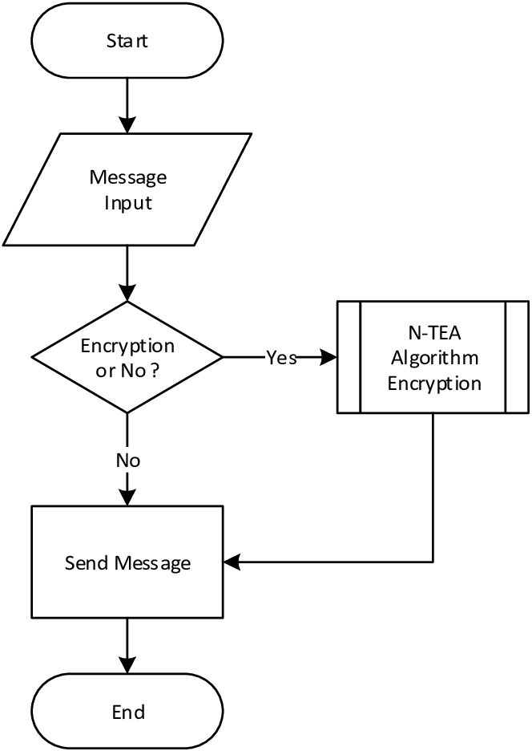
FLOW CHART

Slide 8
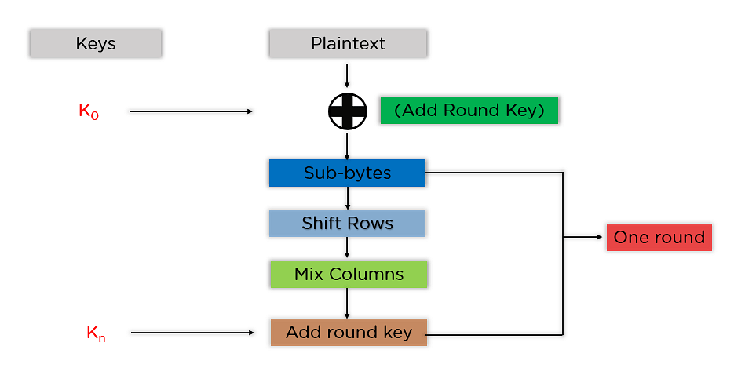
In AES algorthim Steps that are involved are

Slide 9
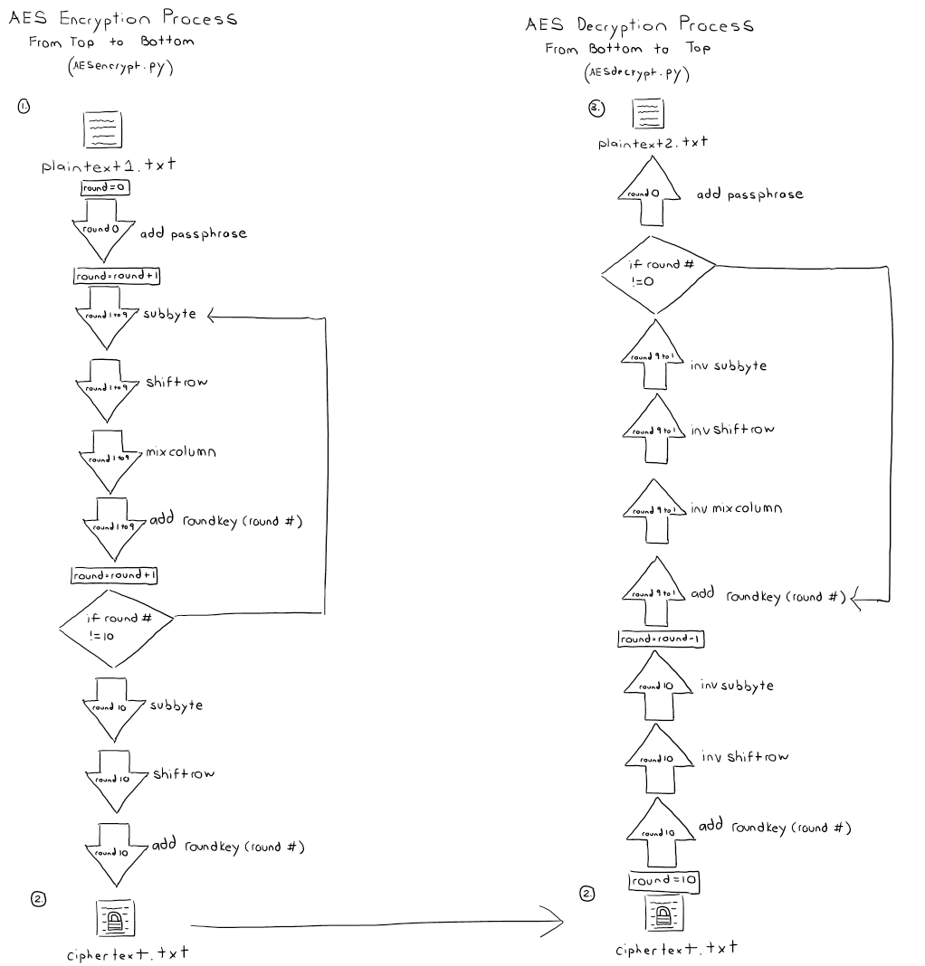
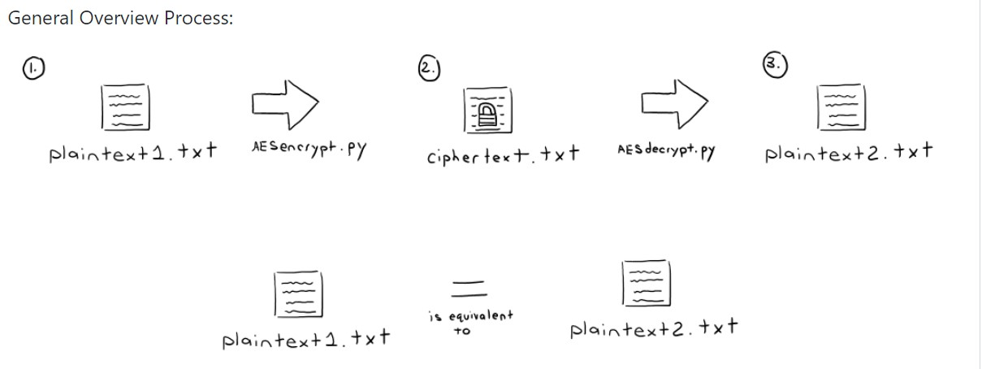
AES ENCRYPTION AND DECRYPTION

Slide 10
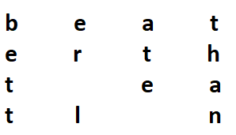
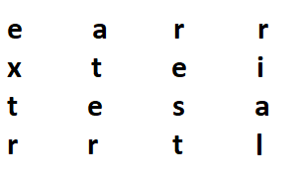
Dividing data into blocks
the very first step of AES encryption is dividing the plaintext into these blocks. For example, it can be “better late than never”.
Key expansion: In is an important step of AES encryption. It produces new 128-bit round keys with the help of Rijndael’s key schedule.

Slide 11
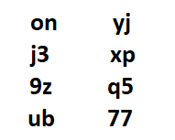
characters won’t be so random after all, as Rijndael’s key schedule uses specific processes to encrypt each and every symbol.

Slide 12

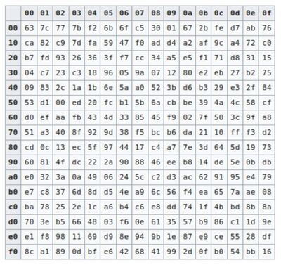
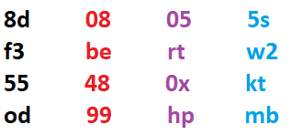
Sub bytes
AES algorithm substitutes every byte with a code according to a pre-established table called the Rijndael S-box. It looks like this:
According to the table, an element like 19 becomes d4, e9 becomes 1a, and so on. So, after the process of byte substitution, my block of cipher might take the appearance of something like this
hypothetical representation of what the real deal looks like

Slide 13
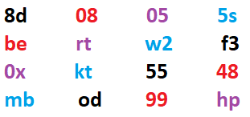
Shift rows
the AES algorithm shifts the rows of the block it got during the byte substitution process
The first row stays put. However, the second row gets shifted to the left by one byte, the third row moves to the left by two bytes, while the last one gets shifted by three bytes:

Slide 14
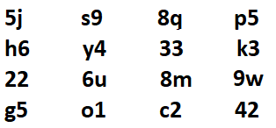
Mix column
this step multiplies each column by a predefined matrix, giving us a brand new block of code.
it is a really complicated process, involving a lot of advanced level mathematics.

Slide 15
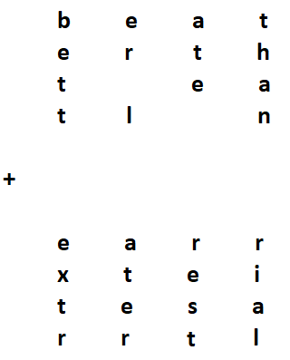
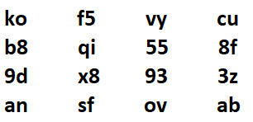
Add-round key
first round of AES encryption. Here, the algorithm adds the initial key to our phrase, which was previously turned into a 4x4 block:
AES uses binary code, now we see visual representation of what is happening in the binary language.

Slide 16
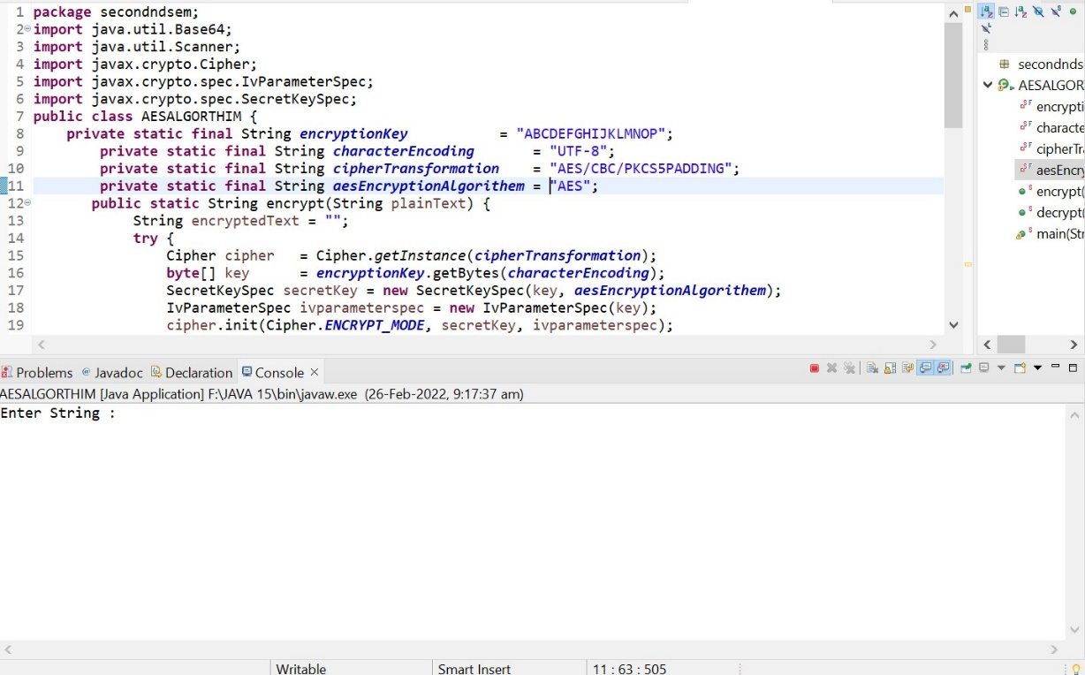
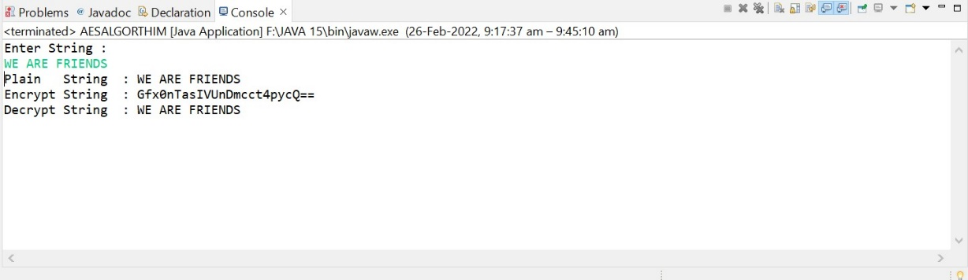
implementation

Slide 17
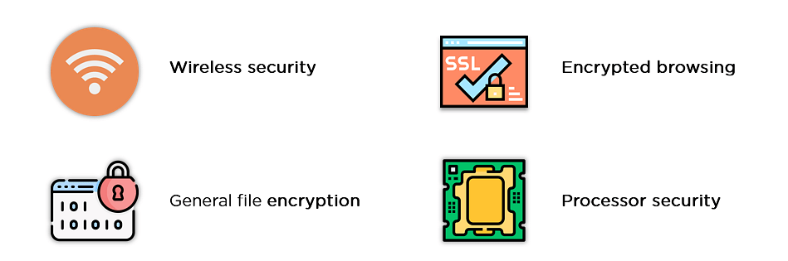
Conclusion
We AES algorithms to establish security services in different service mechanisms.
If we want to send message quickly we use private key AES algorithm and if we want to send messages secretly we use public key algorithm.

Slide 18
OFFICE network
Implementing ipv6 addressing Scheme

Slide 19
Abstract
IP Addresses
An IP address is an address used in order to uniquely identify a device on an IP network.
The address is made up of 32 binary bits, which can be divisible into a network portion and host portion with the help of a subnet mask.
The 32 binary bits are broken into four octets (1 octet = 8 bits). Each octet is converted to decimal and separated by a period (dot). For this reason, an IP address is said to be expressed in dotted decimal format (for example, 172.16.81.100). The value in each octet ranges from 0 to 255 decimal, or 00000000 - 11111111 binary.

Slide 20
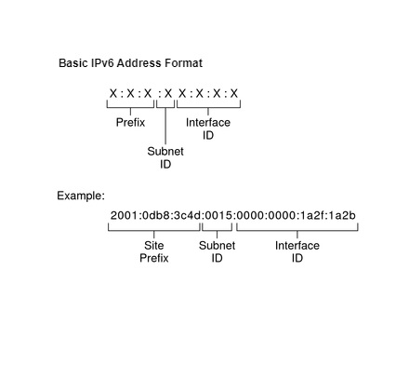
Introduction
An IPv6 address is 128 bits in length and consists of eight, 16-bit fields, with each field bounded by a colon.
Each field must contain a hexadecimal number, in contrast to the dotted-decimal notation of IPv4 addresses. In the next figure, the x's represent hexadecimal numbers.

Slide 21
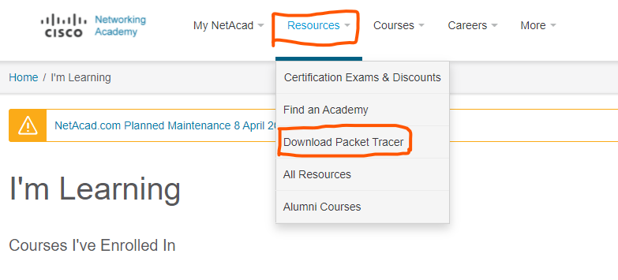
Cisco packet tracer
Login to Cisco Netcad (https://www.netacad.com/)
Click on Resources and select Download Packet Tracer

Slide 22
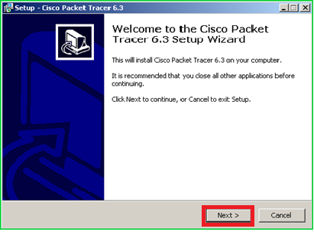
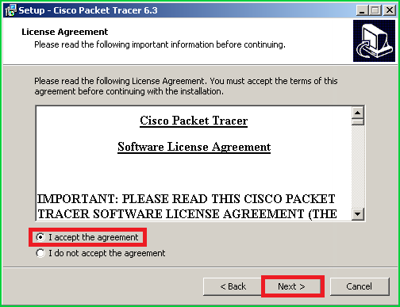
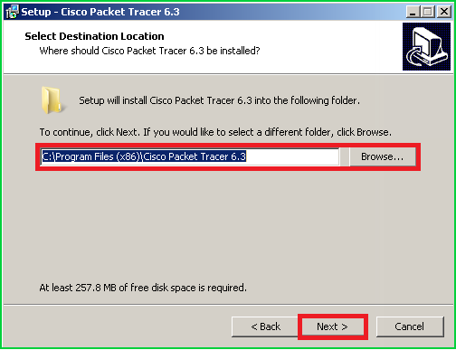
Cisco packet tracer Installation

Slide 23
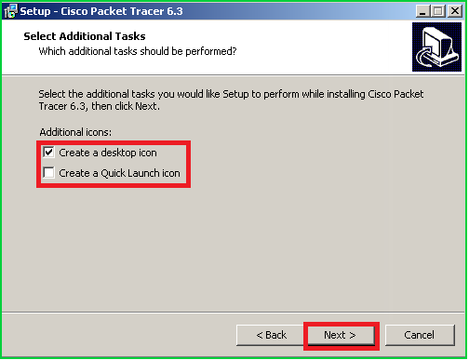
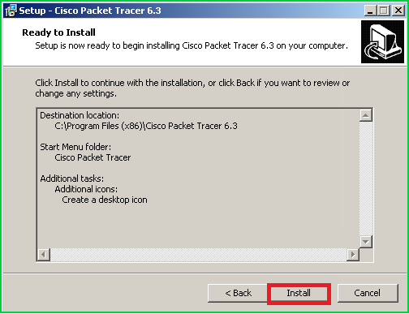
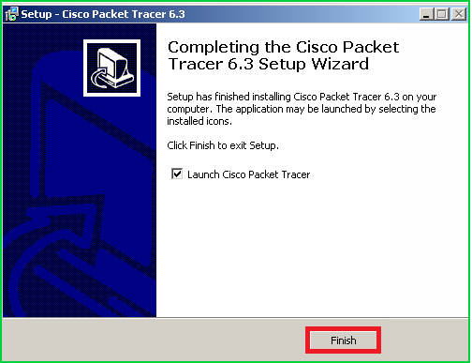
Cisco packet tracer Installation
After Installation Again login with Cisco Netcad credentials

Slide 24
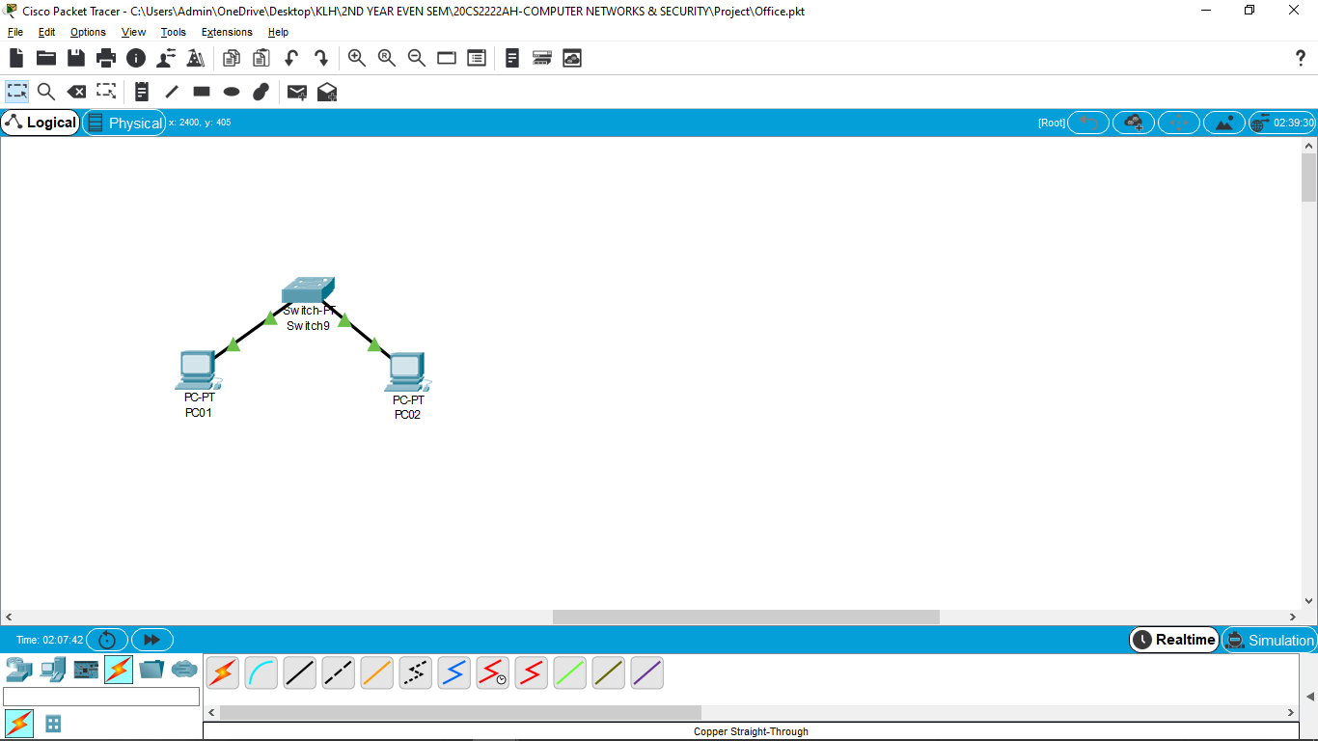
Ipv6 configuration with 2 pcs
Connect two pcs to a switch with copper straight wire

Slide 25

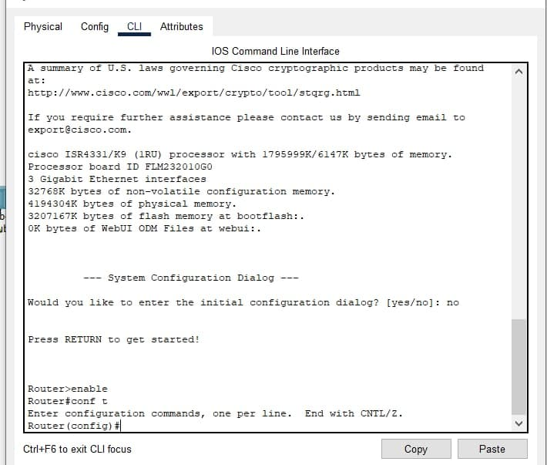
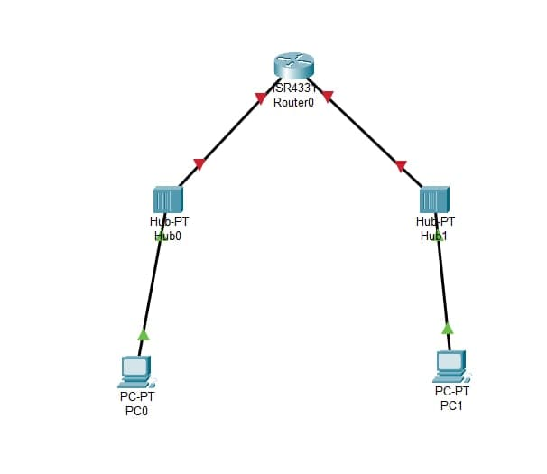
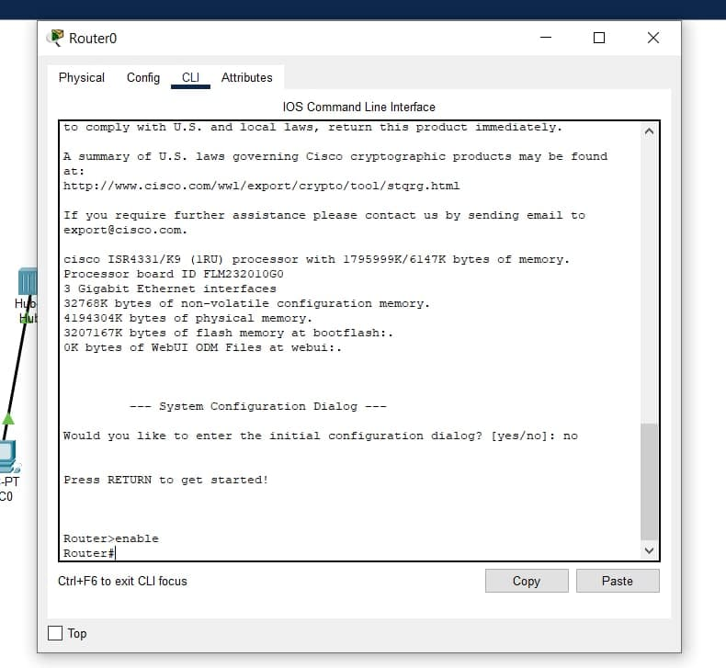

Ipv6 configuration with 2 pcs

Slide 26
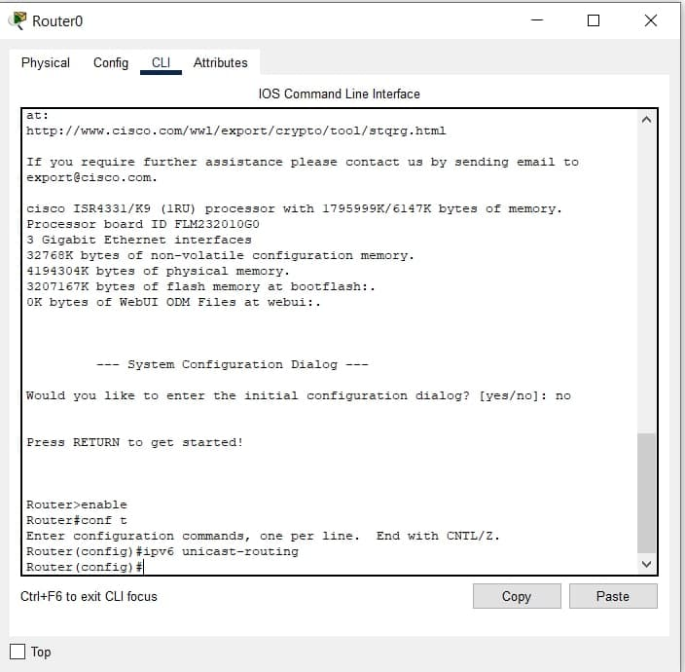
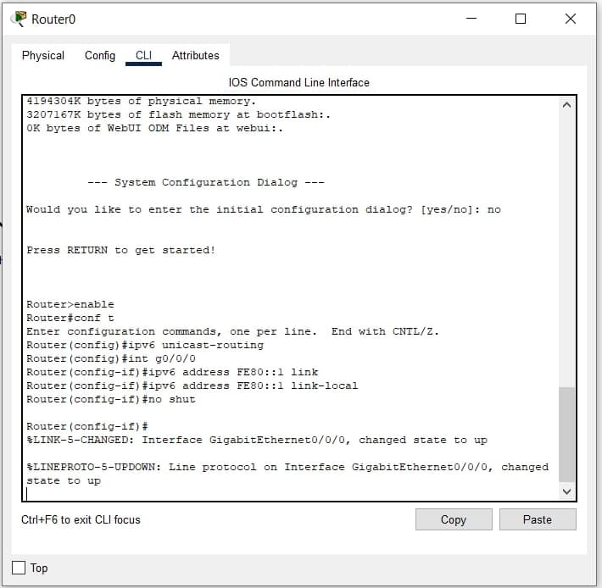

Slide 27
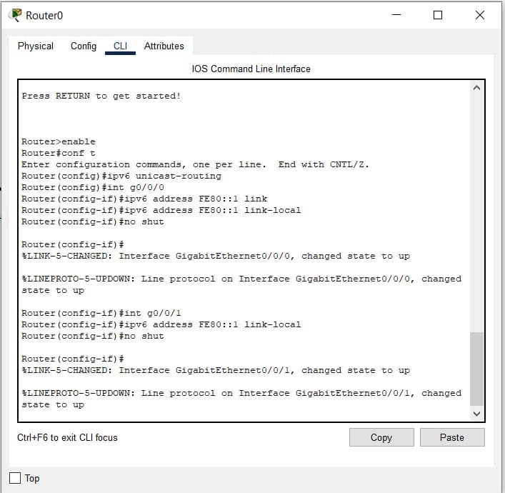
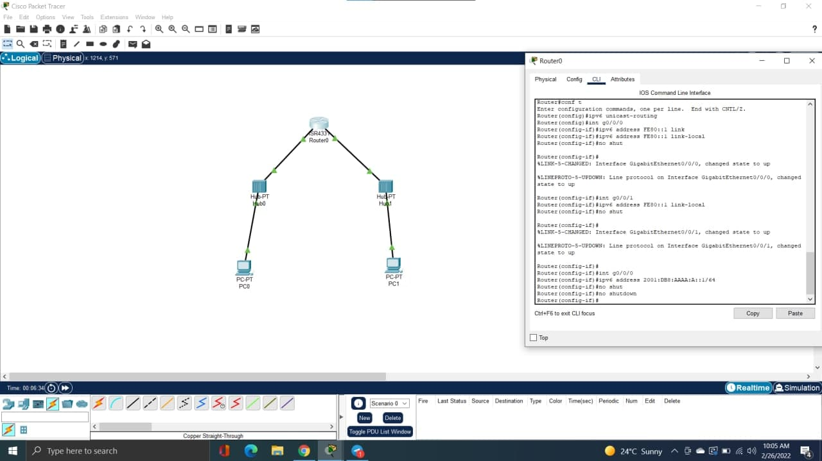

Slide 28
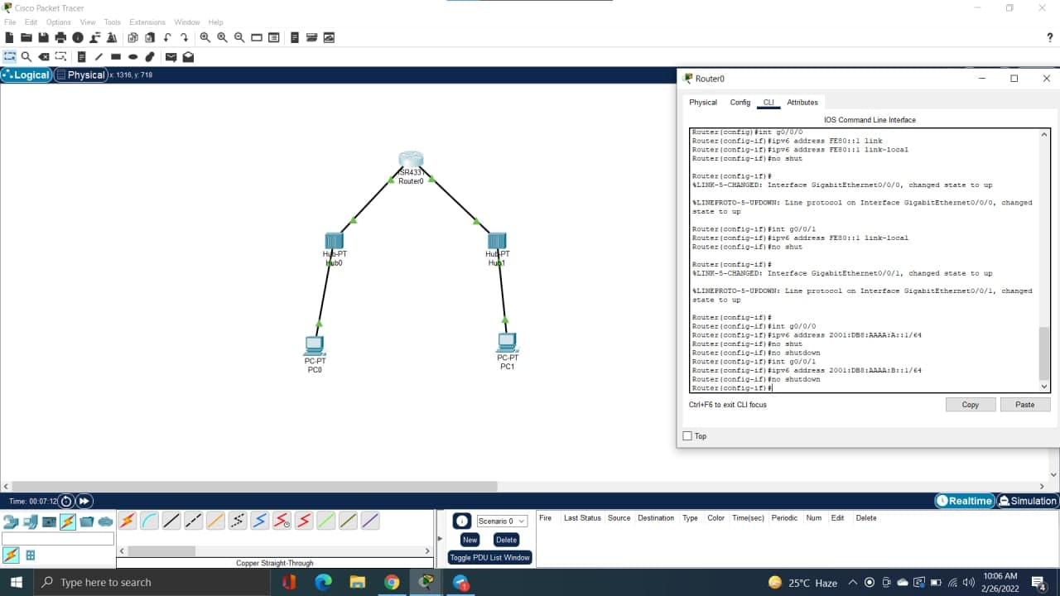
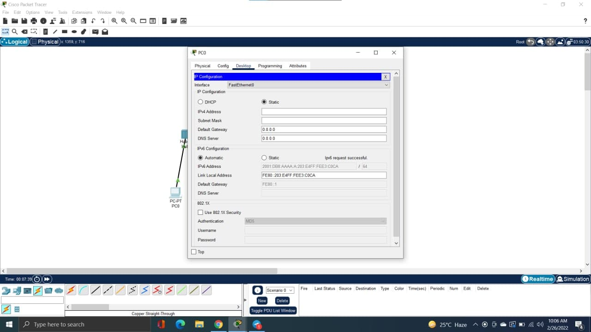

Slide 29
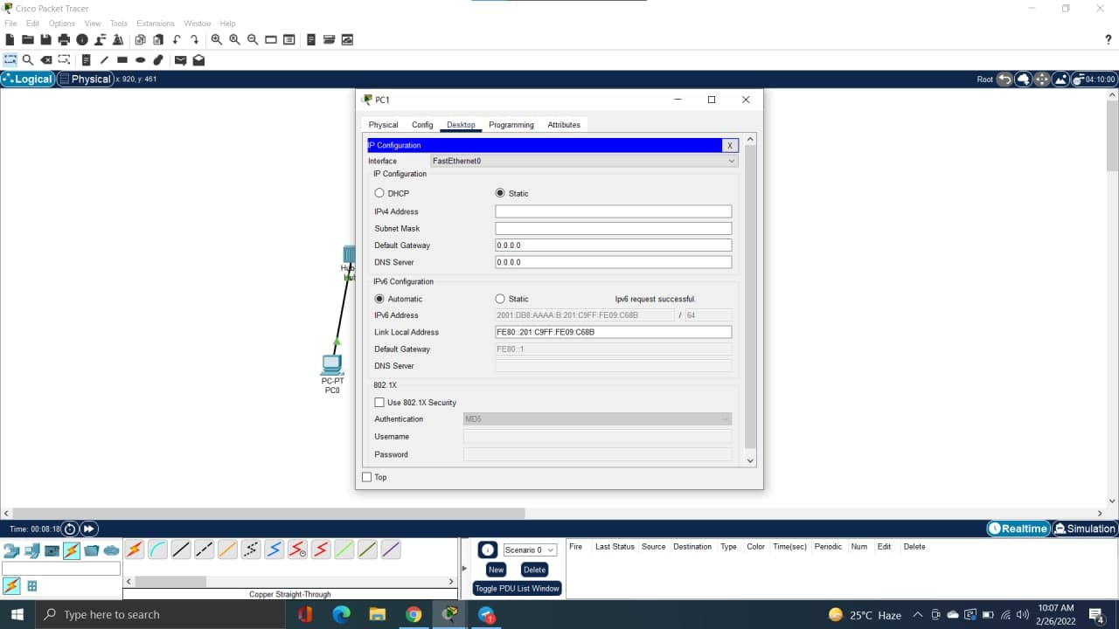

Slide 30

THANK YOU

